Slide 1
PERFORMING ARTS
DANCE

Slide 2
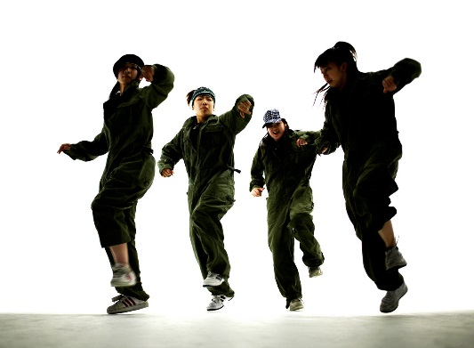
Lesson Objective:
Introduction to dance- understand the expectations of you in dance and the safety aspects in the dance studio
What are the 5 basic actions and how can we use them?
What does an EFFECTIVE warm up consist of

Slide 3
Success Criteria
Level | Dance Strand
 | 1 Creating | 2 Performing | 3 Reflecting
Entry | I can remember a range of actions I can create phrases based on a stimulus or music | I can participate in a short group performance I show some consideration of spatial awareness in performance | I can recognise when my own work and the work of others’, could be improved
1 | I can perform simple dance phrase demonstrating choreographic skills | I can use appropriate characterisation in a performance | I can talk about why I made certain decisions in my choreography I can show a basic understanding of how a stimuli can be conveyed
2 | I can create a choreography using unison and cannon I can learn teacher led sequences and then use these to develop my own levels I can create a choreography using a range of stimuli I can take on feedback to improve my choreography such as using levels and/or contract work I can sustain a focus within a performance | I can learn a routine and take part in simple performances | I can give suggestions on how work could be improved I can talk about my work using some dance terminology I can identify strengths and weaknesses in my own and others work
3 | I can select and apply movement to match the given dance style I can work confidently in a group using a range of choreographic devices to explore different dance styles and ideas I can create and rehearse performance that make use of the range of techniques and dynamics to express my ideas I can give and accept suggestions to/from peers and teachers during the rehearsal process I can learn and create dances in a variety of styles | I experiment with different actions to create a performance I can create routines that are appropriate to the given style or stimuli I can experiment with different styles/actions and dynamics when developing a routine I improve and refine my performance through the rehearsal process I can choreograph a short performance for an audience I can perform a variety of different dance styles | I can reflect on and evaluate my own and other pupils’ work, suggesting improvements I can use key words when talking about dances that I have seen or participated in I can discuss the ways that ideas are communicated

Slide 4

FIZZ BUZZ
YOU HAVE TO JUMP FOR FIZZ AND SPIN FOR BUZZ
All pupils stand in a circle in the room. Go round the circle counting from one upwards, in number order. If a pupil says a multiple of 3 they JUMP and if they say a multiple of 5 they say SPIN. If they say a multiple of 3 and its also a multiple of 5 then they say JUMP AND SPIN at the same time.
Skills Required
Listening to others
Knowing your timetables
Thinking quickly
Concentrating
BE AWARE OF YOUR SPACE!

Slide 5
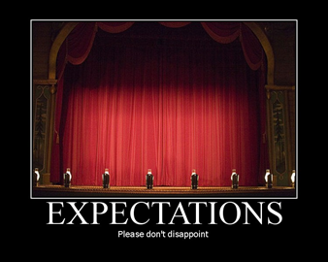

EXPECTATIONS
BE RESPECTFUL OF OTHERS IN THE CLASS.
TRY YOUR HARDEST AT ALL TIMES.
LISTEN TO FEEDBACK AND USE THIS CONSTRUCTIVELY TO IMPROVE YOUR PERFORMANCE.
LISTEN TO THE TEACHER AT ALL TIMES.
BE ABLE TO WORK AS A GROUP AND INDEPENDENTLY.
BE CREATIVE.
USE THE STAGE EFFECTIVELY.
LISTEN TO YOUR PEERS IDEAS

Slide 6

WARM UP-why do we warm up?
A warm up has 3 sections-
Pulser raiser,
Co-ordination
stretch.
CLASS DISCUSSION:Can you think of any exercises that would be good for each section?
Why do we warm up?
SOCKS OFF, HAIR UP, LINES OF 5, FEET IN PARALLEL
LETS GO!

Slide 7
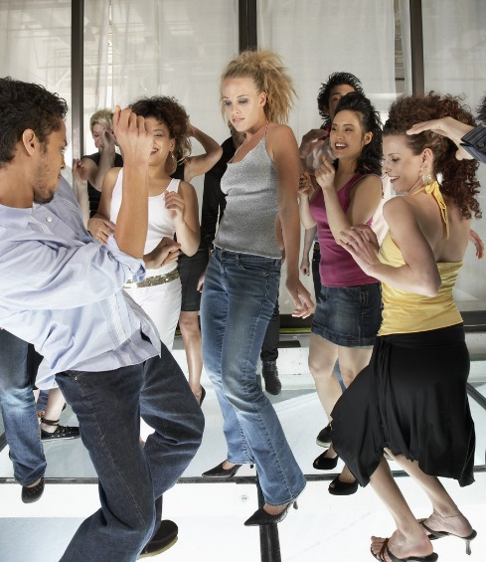
KEY WORDS
ACTION-WHAT
DYNAMIC-HOW
SPACE-WHERE
RELATIONSHIPS-WHO
RHYTHM-TIMING
FOCUS

Slide 8

TASK 1
Turn to the person next to you and identify as many pulse raisers, co-ordination and stretches from the warm up you just completed.
2 MINUTE TASK
Create 3 Pulse raisers.
Share with the group.

Slide 9
5 BASIC ACTIONS- how were these used in the warm up?
The 5 basic actions are
Jump
Hop
Travel
Stillness/gesture
Turn/rotate

Slide 10

INTRODUCTION TO STREET DANCE
WATCH THE FOLLOWING STREET DANCE VIDEO. WHAT DO YOU THINK THE KEY SKILLS OF STREET DANCE ARE?
https://www.youtube.com/watch?v=0DfRyZ7o2WY

Slide 11
STREET DANCE TASK
YOU WILL NOW START TO LEARN THE OPENING SECTION TO YOUR STREET DANCE ROUTINE.
REMEMBER TO TRY YOUR HARDEST☺
LISTEN TO THE BEATS OF THE MUSIC

Slide 12
PLENARY
What have you learnt today?
What are the key aspects of a warm up?
What are the 5 basic dance actions?
What are the key skills of street dance?
Each corner of the room is a level. Go to the corner you think you are at and be ready to explain why and how you could improve.

